Slide 1
Calendar Share
Group 9

Slide 2
Team Roles
Joseph Hill – Project Manager/Backend
Robert Law – Backend
Barry Latour – Web Frontend
Jacob Haake – Web Frontend and Security
Joel Robertson – Mobile
Miguel Cordero - Mobile

Slide 3
Application Explanation
Event driven platform designed to help users be more engaged in their community
Create or join groups to share events
Add friends and invite them to groups
Groups are collection of people and associated events

Slide 4
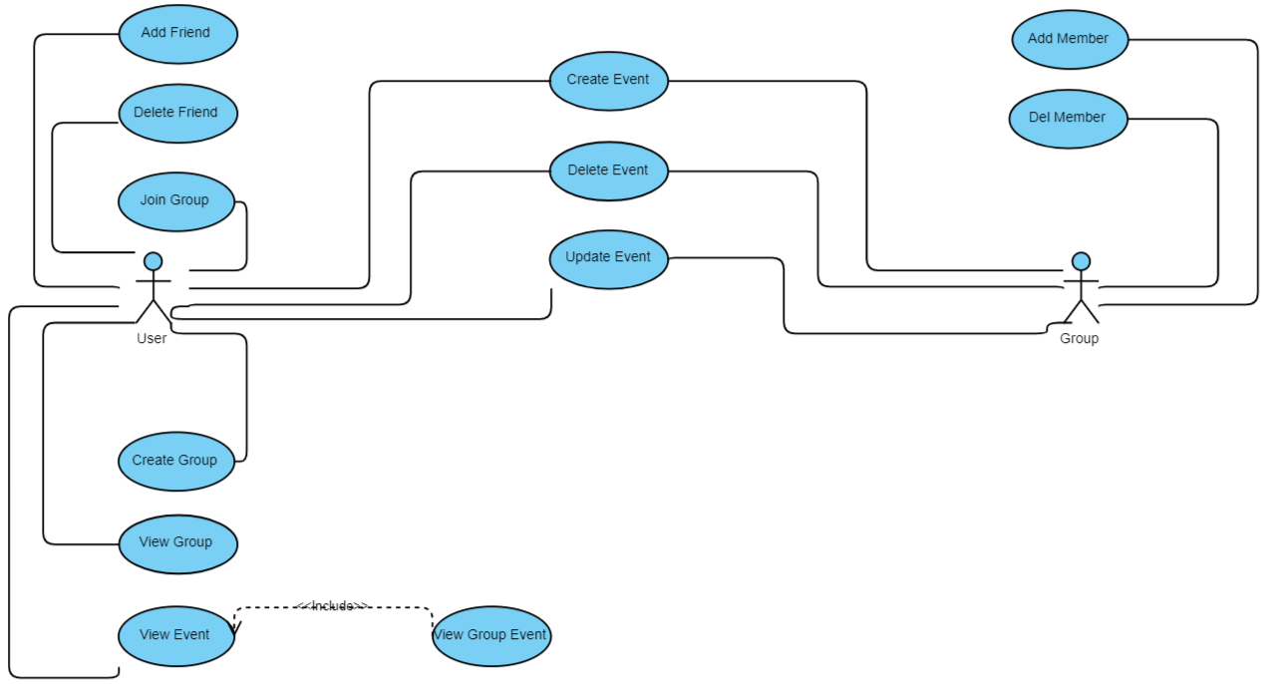
Use Case Diagram

Slide 5
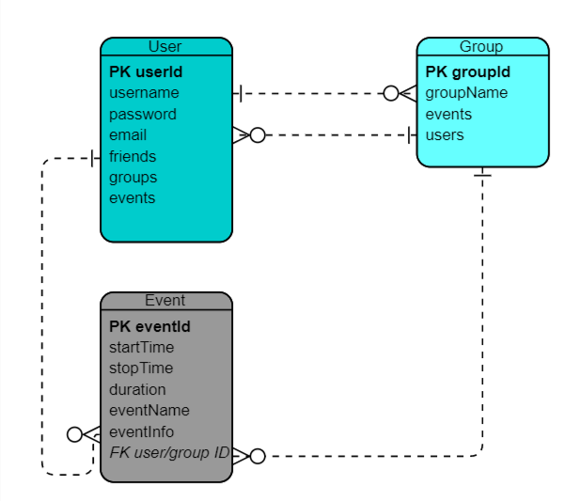
Entity Relationship Diagram

Slide 6
Backend Technology
MongoDB – NoSQL Database
Nodejs – JavaScript runtime
Express – Web framework
Heroku – cloud hosting platform
OAuth – secure access to application data
Postman – API testing

Slide 7

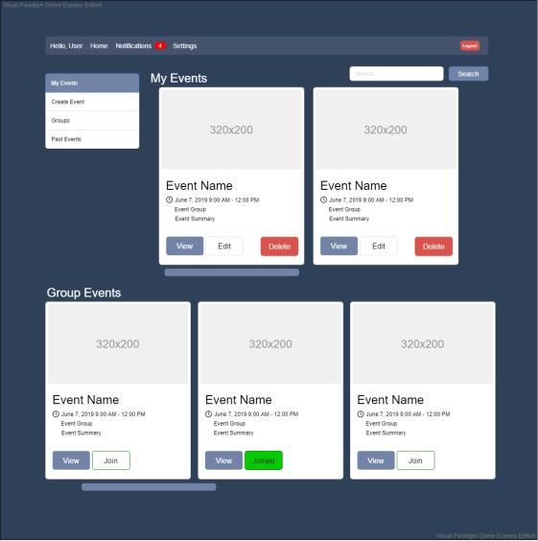
Web Prototype

Slide 8
Web Technology
React – front end framework
mdbootstrap – bootstrap components for React
Bcrypt.js – hash and salt passwords
Axios – https client
Passport.js – authentication with Facebook, Google+ LinkedIn
Mocha.js – JavaScript test framework

Slide 9
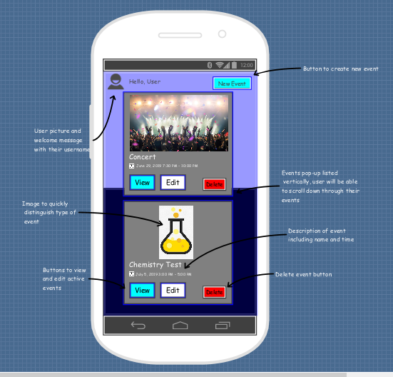
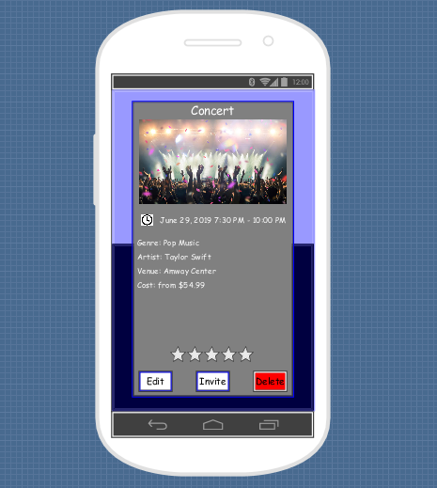
Mobile Prototype

Slide 10


Mobile Technology
Flutter – mobile application framework
Dart – programming language for Flutter
Target Mobile OS - Android

Slide 11
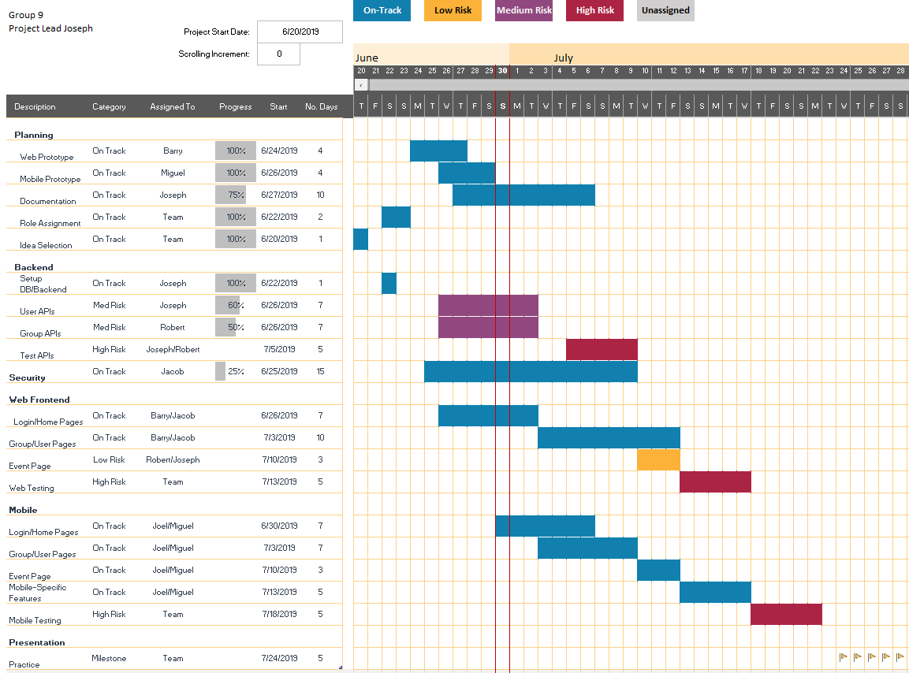

Slide 12
Monetization
Local businesses can promote their events to local users
Advertisements for popular upcoming events
Booking service

Slide 13

Questions?

